Slide 1
5-Creating A KeyPair

Slide 2
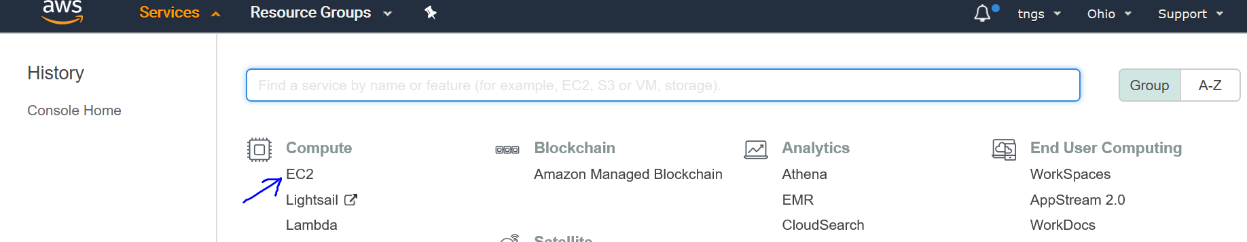
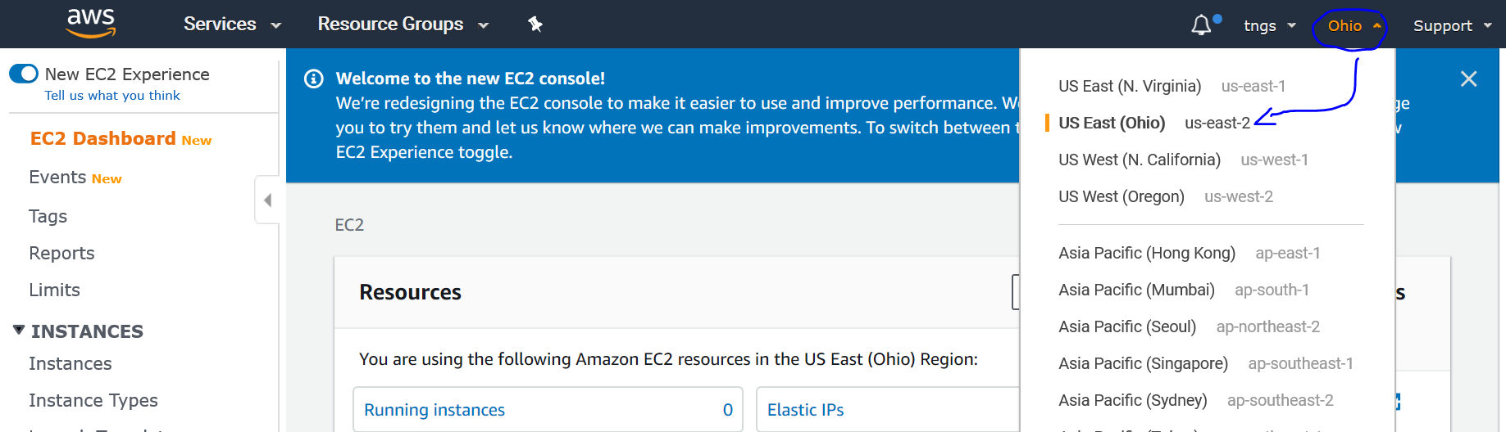
CREATING A KEY PAIR
Open below URL to login to AWS console.
https://console.aws.amazon.com/
On the header of the console page, click on Services, then Click on EC2 under Compute menu.
Next, select your region from top right-side drop-down menu as shown below.

Slide 3
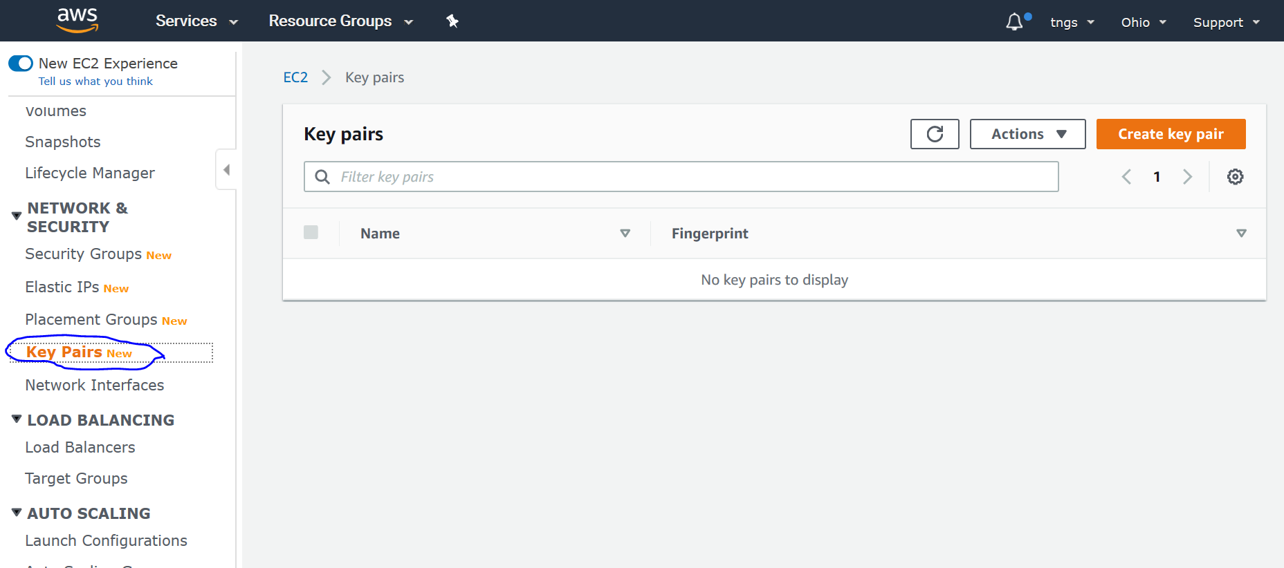
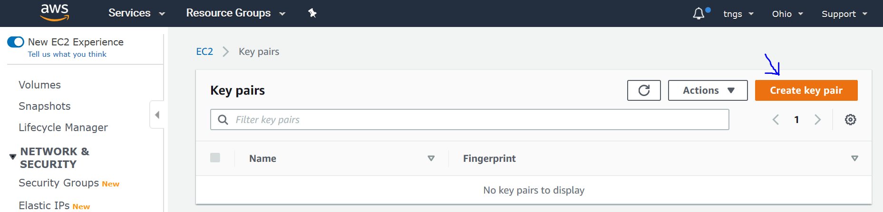
Then Click on Key Pairs under NETWORK & SECURITY menu on the left pane below.
Then Click Create Key Pair on the right upper corner.

Slide 4
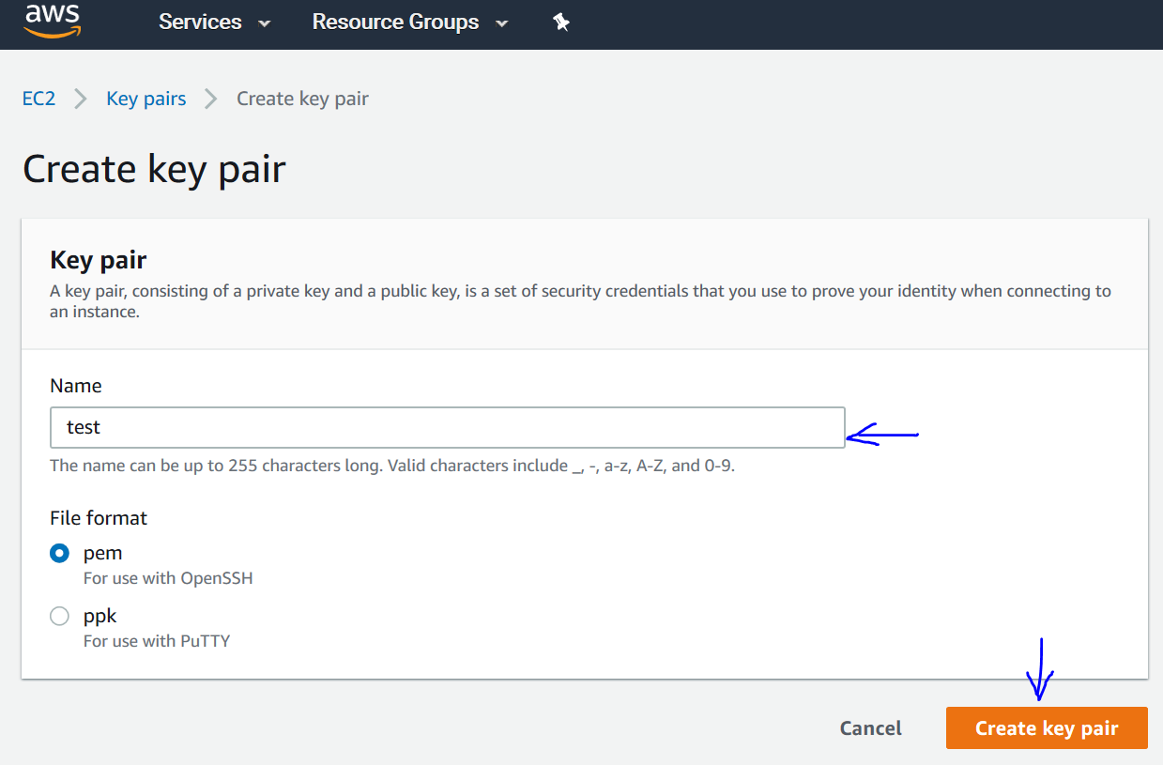
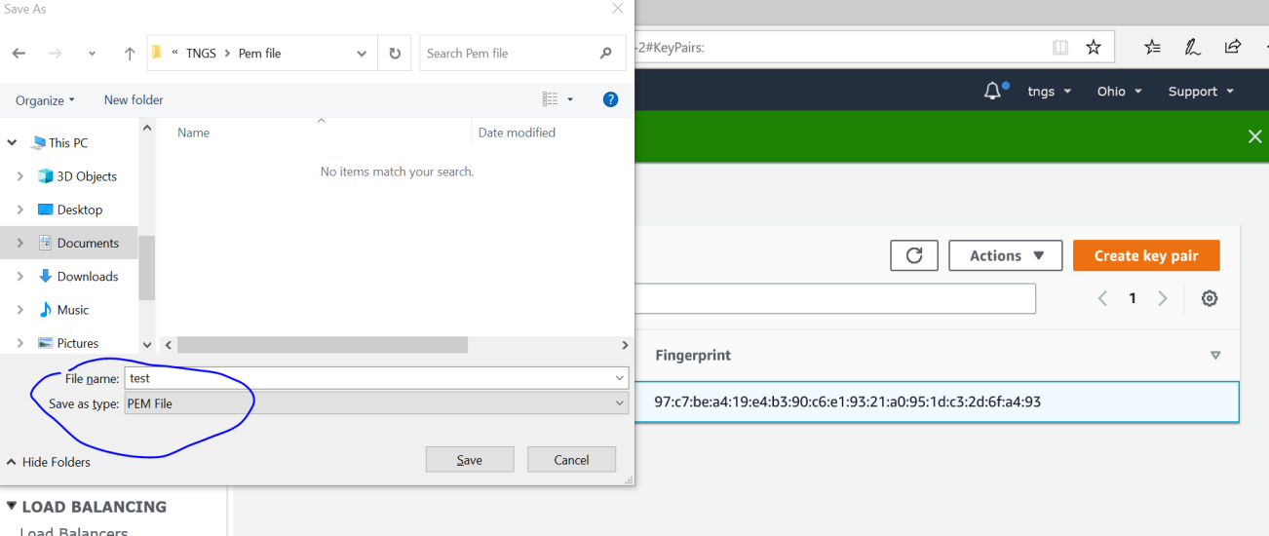
Specify a name for your Key Pair and click on Create.
A popup window will come and ask you to save the Key pair click on OK to save your key pair. This is the last and first time you are going to save this file.
Place your Key Pair in a secure location, if we lost it, we cannot restore.

